Slide 1
LEARNING PYTHON 20220928
4110E228

Slide 2
CONTENT:
WHAT IS PYTHON?
PYTHON JOBS
WHY TO LEARN PYTHON?
PYTHON ONLINE INTERPRETER
ONE
TWO
GOOGLE COLAB
PYTHON CODES

Slide 3
WHAT IS PYTHON?
Python is an interpreted, object-oriented, high-level programming language with dynamic semantics. Its high-level built in data structures, combined with dynamic typing and dynamic binding, make it very attractive for Rapid Application Development, as well as for use as a scripting or glue language to connect existing components together. Python's simple, easy to learn syntax emphasizes readability and therefore reduces the cost of program maintenance. Python supports modules and packages, which encourages program modularity and code reuse. The Python interpreter and the extensive standard library are available in source or binary form without charge for all major platforms, and can be freely distributed.
Often, programmers fall in love with Python because of the increased productivity it provides. Since there is no compilation step, the edit-test-debug cycle is incredibly fast. Debugging Python programs is easy: a bug or bad input will never cause a segmentation fault. Instead, when the interpreter discovers an error, it raises an exception. When the program doesn't catch the exception, the interpreter prints a stack trace. A source level debugger allows inspection of local and global variables, evaluation of arbitrary expressions, setting breakpoints, stepping through the code a line at a time, and so on. The debugger is written in Python itself, testifying to Python's introspective power. On the other hand, often the quickest way to debug a program is to add a few print statements to the source: the fast edit-test-debug cycle makes this simple approach very effective.

Slide 4
PYTHON JOBS
A professional who specializes in Python can hold a number of job titles, including;
Python Developer
Data scientist
Machine Learner Engineer

Slide 5
WHY TO LEARN PYTHON?
Year-after-year, Python is one of the most in-demand programming languages for companies. Like most popular programming languages, Python’s popularity didn’t come until years after the language was created. Designed by Guido van Rossum, Python was initially introduced in 1991. By the end of 2000, Python 2.0 was released and the language entered it’s prime because of it’s adaptability and broad use.
Today, Python is on its third iteration and used by most of the world’s top tech companies. Those who learn Python run the gamut from software developer to data scientist to cybersecurity expert.

Slide 6
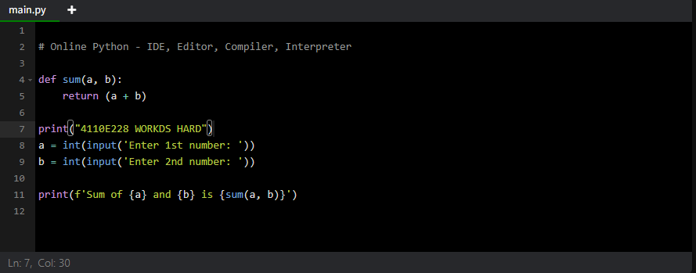
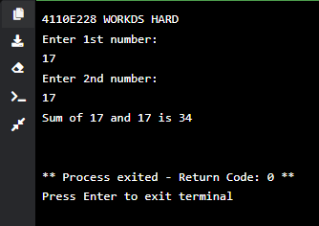
PYTHON ONLINE INTERPRETER 1

Slide 7
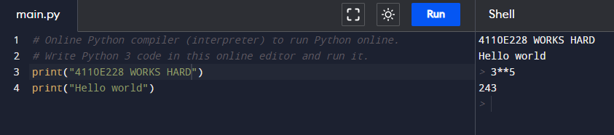
PYTHON ONLINE INTERPRETER 2
INTERACTIVE
Interacttove

Slide 8
INPUT AND OUTPUT 20220928

Slide 9
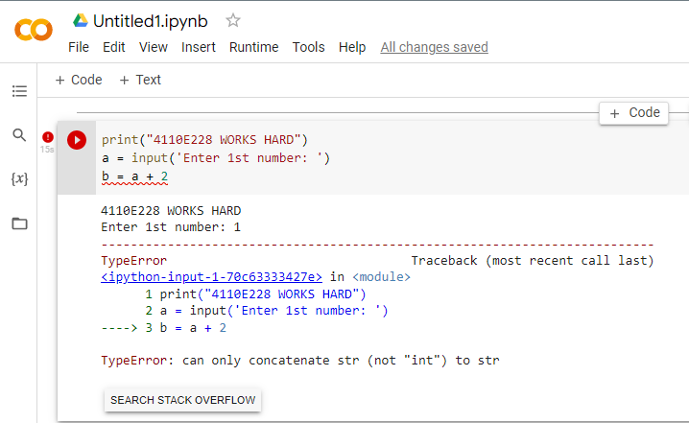
QUESTION:
Data Type

Slide 10
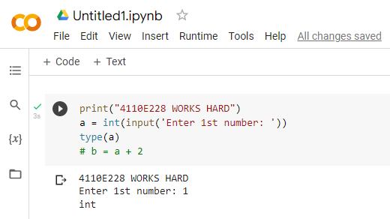
WAY: 1

Slide 11
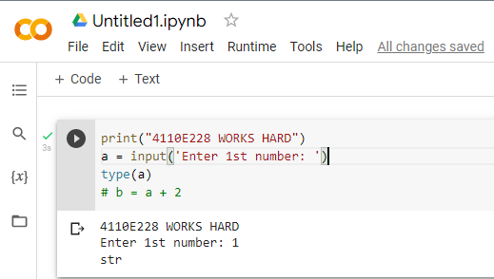
WAY: 2

Slide 12
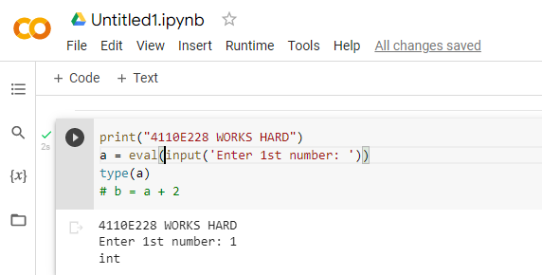
WAY: 3

Slide 13
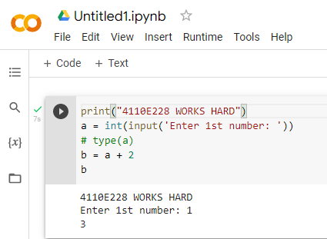
ANSWER: 1

Slide 14
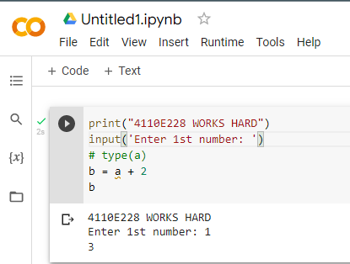
ANSWER: 2

Slide 15
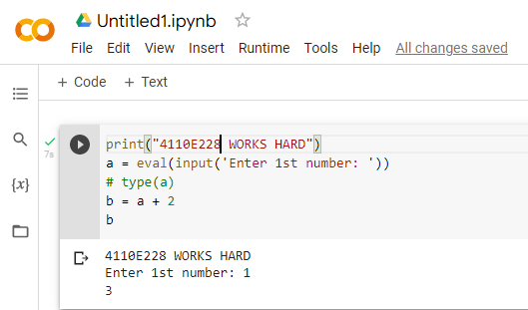
ANSWER: 3

Slide 16
PYTHON DATA TYPES 20220928

Slide 17
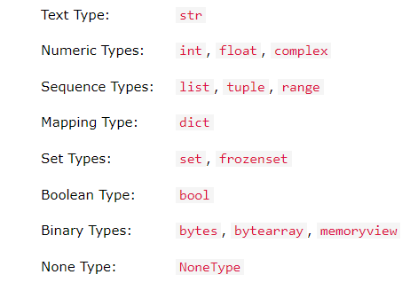
DATA TYPES

Slide 18
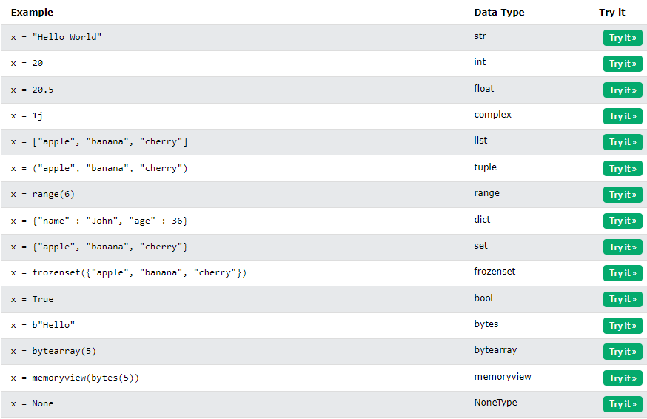
SETTING THE SPECIFIC DATA TYPES

Slide 19
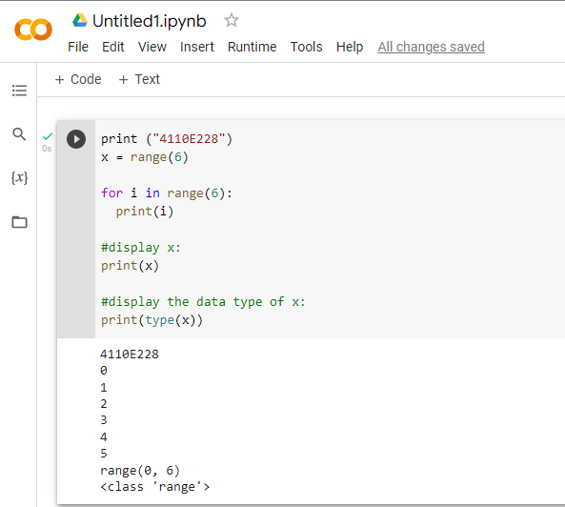
PYTHON DATA

Slide 20
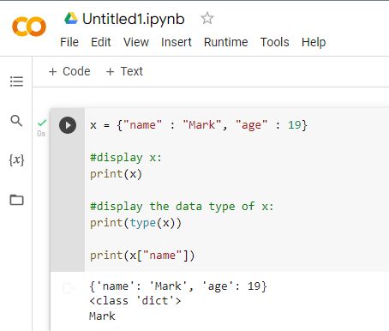
DICT: KEY-VALUE PAIR

Slide 21
PYTHON OPERATORS 20220928

Slide 22
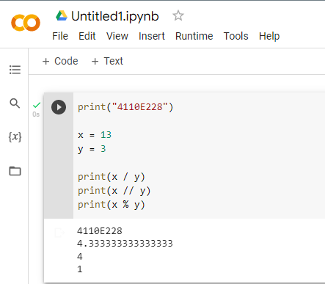
PYTHON ARITHMETIC OPERATORS

Slide 23
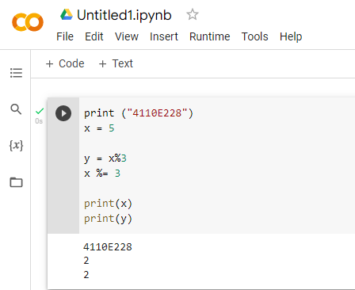
PYTHON ASSIGNMENT OPERATORS

Slide 24
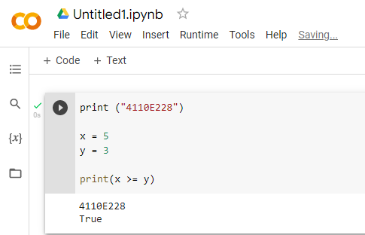
PYTHON COMPARISON OPERATORS

Slide 25
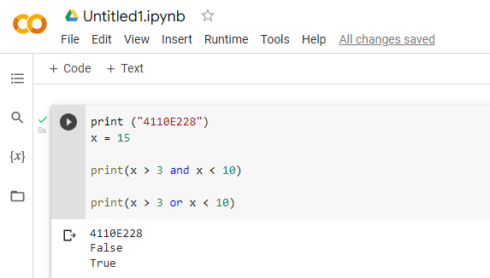
PYTHON LOGICAL OPERATORS

Slide 26
THANK YOU!
CHINESE NAME: 潘卡羅
STUDENT ID: 4110E228
ENGLISH NAME: MARK JAY P. PECJO
NICKNAME: MJ
EMAIL: pecjay11@gmail.com
GITHUB: https://github.com/mjaypecjo

